Slide 1
Lending club Case Study
Shikha Jain
22-Jan-25

Slide 2
Agenda:
Objective: The aim is to identify patterns which indicate if a person is likely to default
Analysis (Univariate, Bivariate)
Results
- Recommendations

Slide 3
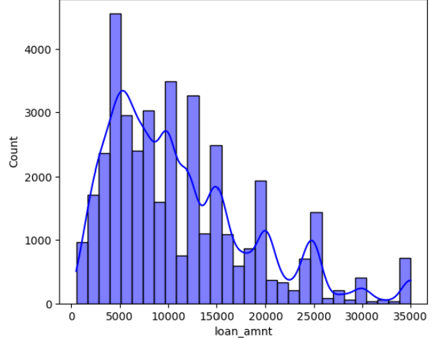
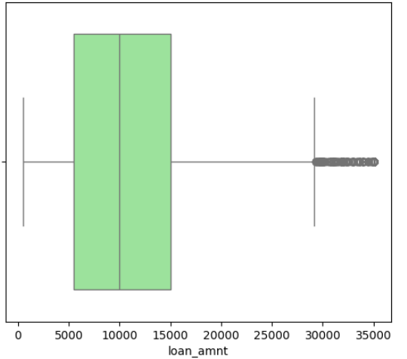
Data analysis: Univariate analysis(loan_amnt)

Slide 4
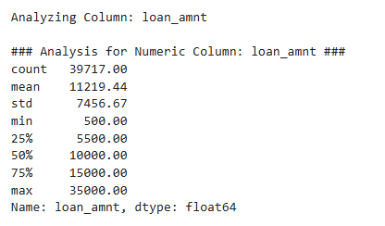
Univariate analysis: loan_amnt
Loan Amount Distribution:
Average loan amount: $11,219
Significant concentration at $5,000
Outliers:
Loan amounts above $29,000 suggest high-value loans
Skewness:
Left-skewed distribution, indicating most loans are smaller
Risk Implications:
Larger loan amounts may correlate with higher borrower risk or financial obligations

Slide 5
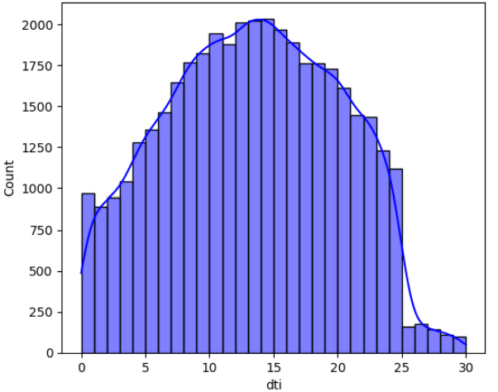
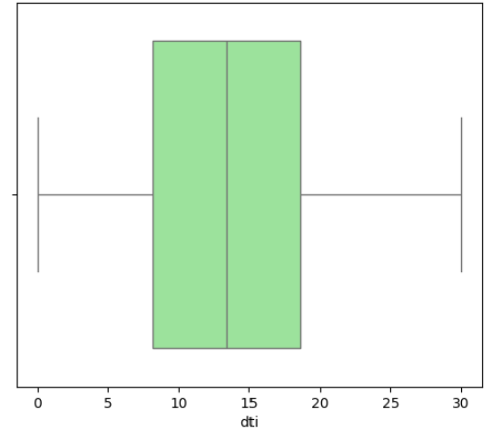
Univariate analysis: dti

Slide 6
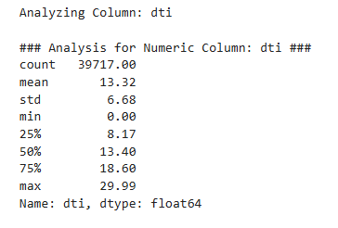
Univariate analysis: dti
DTI Distribution:
Most loans around 13, with a slight concentration at 8.17
Concentration:
Data concentrated between 8 and 18, no significant skew
Risk Implications:
Higher DTI ratio suggests higher borrower debt relative to income, potentially increasing loan risk

Slide 7
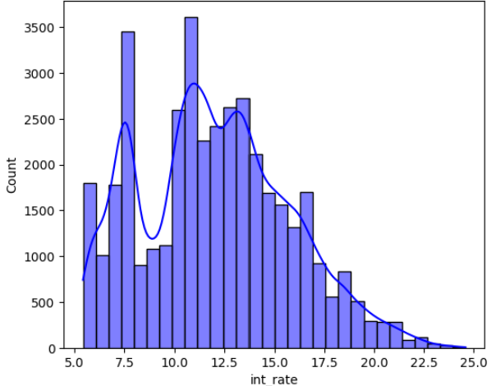
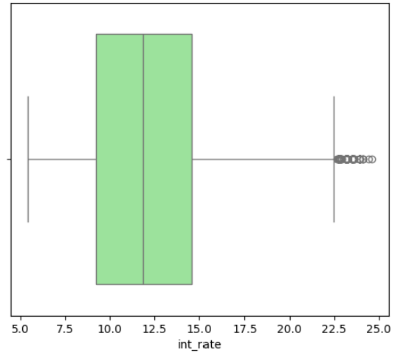
Univariate analysis: int_rate

Slide 8
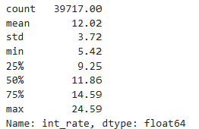
Univariate analysis: int_rate
Interest Rate Distribution:
Majority of loans around 11%
Secondary peak at 7.5%
Outliers:
Interest rates above 22.5% suggest high-risk loans
Low Rates:
5-6% interest rates likely indicate low-risk borrowers
Data Quality:
Moderate distribution with no extreme low-rate outliers, but high-rate anomalies
Risk Implications:
High-interest outliers should be assessed for potential defaults

Slide 9
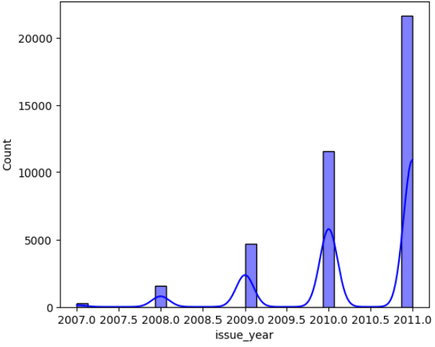
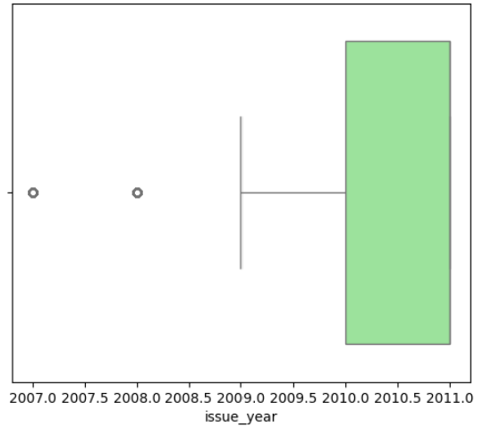
Univariate analysis: issue_year

Slide 10
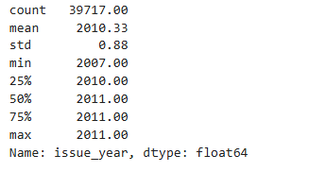
Univariate analysis: issue_year
Issue Year Distribution:
Peak year: 2011
Most loans issued between 2010 and 2011
Skewness:
Data concentrated between 2007 and 2011, indicating a limited issuance period
Outliers:
Few loans issued before 2010
Data Consistency:
Minimal variation in loan issue years, mostly 2010 and 2011

Slide 11
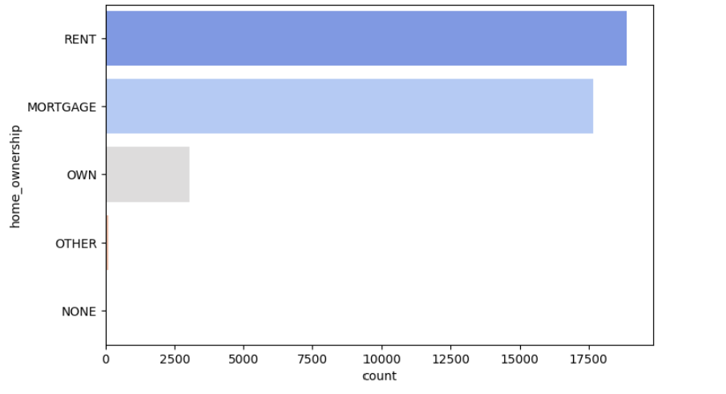
Univariate analysis: home_ownership

Slide 12

Univariate analysis: home_ownership
Home ownership distribution
Most Common Home Ownership Status:
RENT: 18,899 records
MORTGAGE: ~16,000 records
Low Frequency for "OWN":
Only ~3,000 records for "OWN" status
Concentration:
~50% of loans are for renters, indicating possible lower financial stability

Slide 13
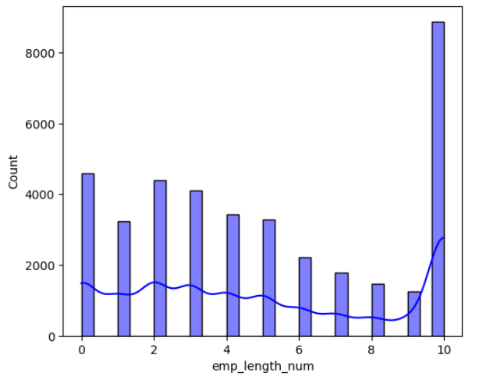
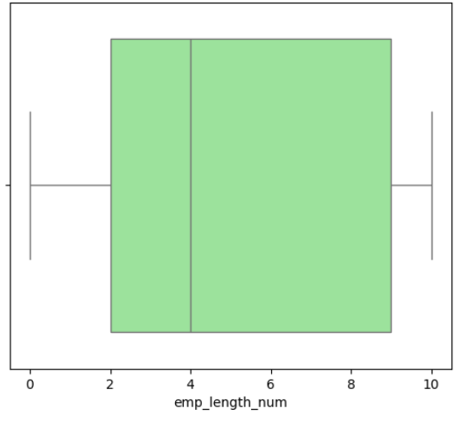
Univariate analysis: emp_length_num

Slide 14
Univariate analysis: emp_length_num
Employment Length Distribution:
Majority of borrowers with 10 years of employment, 8,000+ records
Peak at 10 Years:
10 years of employment is the most common, indicating stable employment for many borrowers
Lower Employment Length:
Next common categories: 0 years and 4k-5k records, likely indicating new or short-tenure borrowers
Data Trends:
More stability at 10 years, with a slight shift toward shorter employment periods

Slide 15
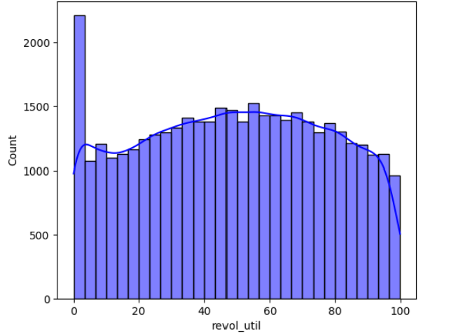
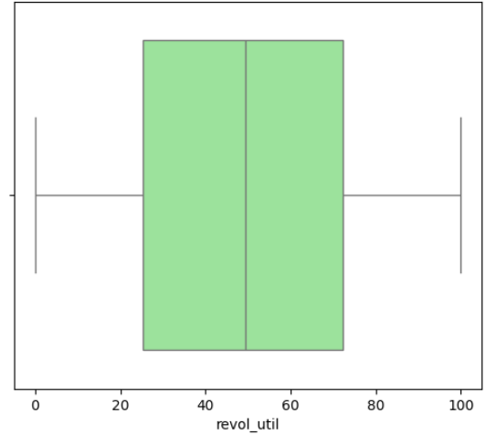
Univariate analysis: revol_util

Slide 16
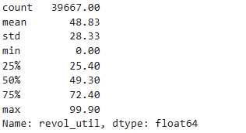
Univariate analysis: revol_util
Distribution:
Most borrowers have revolving credit utilization near 0%, with over 2,000 records at this value
Second Peak:
Secondary peak between 55% and 60%, indicating substantial use of over half of available credit
Lack of Outliers:
No outliers in the boxplot, suggesting uniform data without extreme values
Central Tendency:
Median value: 49.3%, indicating moderate revolving credit usage (half of borrowers use less than 50%)
Risk Implications:
High utilization (near 60%) may indicate higher financial risk
Peak near 0% suggests many borrowers are underutilizing credit

Slide 17
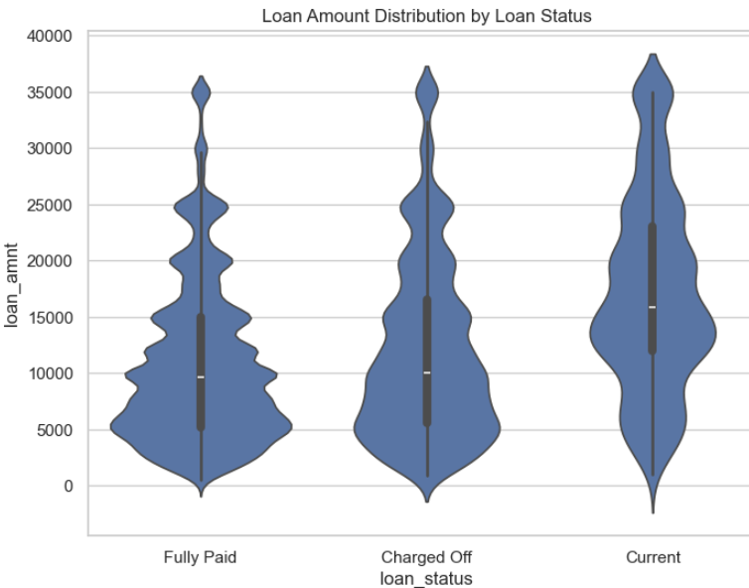
Bivariate analysis: loan_amnt v/s loan_status
Fully Paid Loans:
Show more variability across loan amounts, with some reaching higher values
Wider distribution
Charged Off Loans:
More concentrated around lower loan amounts, with less variation
Tighter clustering
Median Loan Amount:
Both categories have a similar median of $5,000
Outliers:
No significant outliers in either category

Slide 18
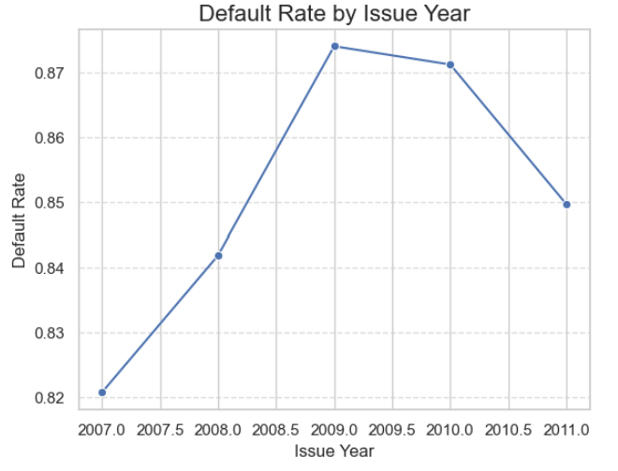
Bivariate analysis: issue_year v/s default_rate
2009: Highest default rate at 0.87, reflecting significant repayment issues during the economic downturn
2008: Default rate around 0.84, showing immediate effects of the financial crisis
2010: Default rate 0.87, indicating lingering recession effects on loan repayments
2007: Lowest default rate, showing pre-crisis stability in loan repayments
Rise in Defaults: Sharp increase in defaults in 2008 and 2009, highlighting financial strain during the global recession

Slide 19
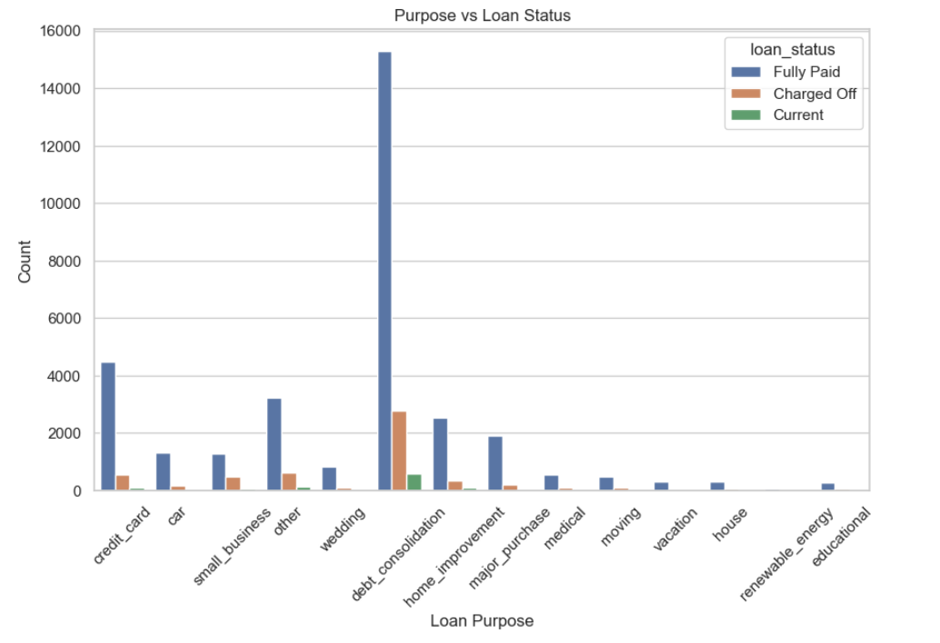
Bivariate analysis: Purpose v/s Loan Status
Loan Purpose & Default Rate:
Debt consolidation loans: High risk of defaults
Educational & renewable energy loans: Lower default rates
Credit card & small business loans: Higher default rates

Slide 20
Results: Univariate analysis Summary
Loan Amount (loan_amnt):
Larger loans (> $29,000) could indicate higher borrower risk, increasing the likelihood of default.
Debt-to-Income Ratio (dti):
Higher DTI ratios suggest higher borrower debt relative to income, correlating with increased default risk.
Interest Rate (int_rate):
Higher interest rates (> 22.5%) suggest high-risk loans, often associated with defaulters.
Issue Year (issue_year):
Loans issued mainly between 2010-2011 indicate economic conditions that could influence default patterns.
Home Ownership (home_ownership):
Renters may be at higher risk of default due to lower financial stability compared to homeowners or mortgage holders.
Employment Length (emp_length_num):
Shorter employment durations (< 2 years) may correlate with higher default risk due to job instability.
Revolving Credit Utilization (revol_util):
High credit utilization (> 50%) indicates financial strain, leading to higher default risk.

Slide 21
Results: Bivariate analysis Summary
Loan Amount vs Loan Status:
Larger loans → higher default rates (Charged Off)
Smaller loans → higher full-payment rates
Insight: Larger loans increase default risk.
Issue Year vs Default Rate:
Higher defaults post-2008 financial crisis
Insight: Economic downturns increase default risk.
Purpose vs Loan Status:
Debt consolidation & small business loans → higher defaults
Education & vacation loans → lower defaults
Insight: Riskier loan purposes correlate with higher defaults.

Slide 22
Recommendations
Scenario: Univariate analysis of loan_amnt: Use log transformation to reduce skewness for machine learning purposes
Scenario: Univariate analysis of dti: Create categories (e.g., low, medium, high DTI) to better understand borrower risk

